Slide 1
GAGNE’S EIGHT LEVELS OF LEARNING
Robert Mills Gagne (August 21, 1916 – April 28, 2002)
BY
Dr.D.Ponmozhi,
Principal,
O.P.R.Memorial College of Education,
Vadalur- 607303.
Cuddalore Dt.

Slide 2
Synopsis
Author
Principles of Learning
Components of Learning-
    Conditions of Learning
    Events of Learning
    Out comes of Learning
Educational implications

Slide 3
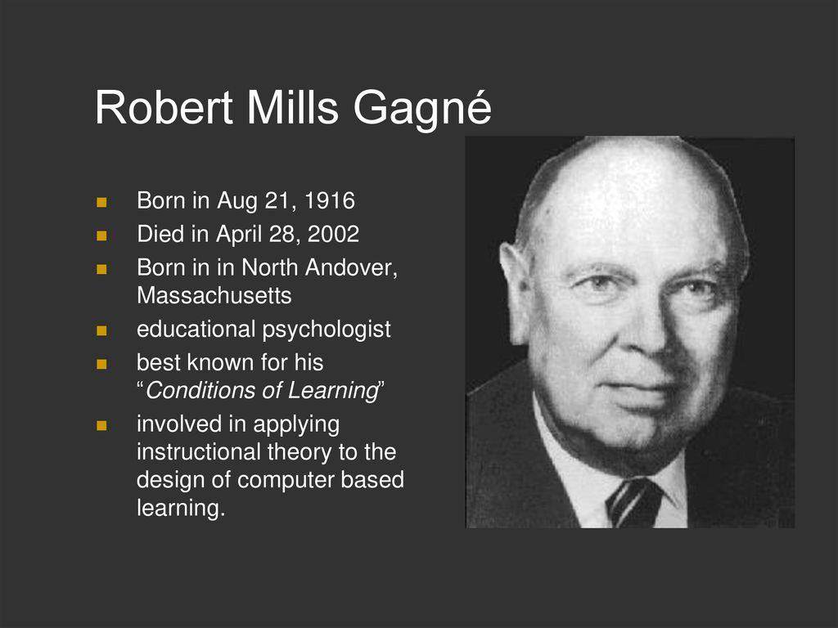

Slide 4
Principles
Different instruction is required for different learning outcomes.
Events of learning operate on the learner in ways that constitute the conditions of learning.
The specific operations that constitute instructional events are different for each different type of learning outcome.
Learning hierarchies define what intellectual skills are to be learned and a sequence of instruction.

Slide 5
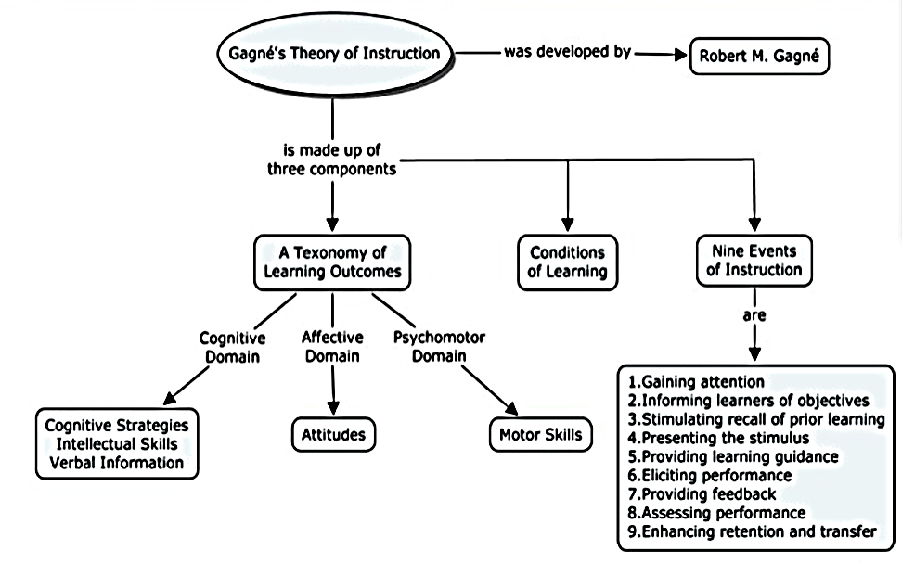
Gagne’s Concept of Learning

Slide 6
3 COMPONENTS OF LEARNING
9 events of instruction
Conditions of Learning
Learning Out comes

Slide 7
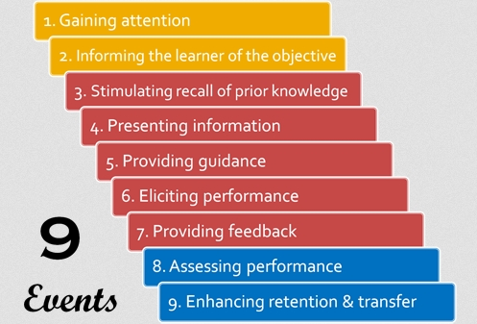

Slide 8

I. 9 events / steps of instruction
These 9 events of instruction take place in a semi-sequential order, and are considered external events that help learning to occur. They are:
1. Gaining Attention - Present stimulus to ensure reception of instruction
2. Informing the Learner of the Objective - The reason for learning
3. Stimulating Recall of Prior Knowledge - Building upon existing relevant knowledge
4. Presenting Information - The actual learning content is delivered

Slide 9
9 events / steps of instruction conti---
5. Providing Guidance - Makes the learning as meaningful and understandable as possible
6. Eliciting Performance - The learners respond to demonstrate the extent of knowledge learnt
7. Providing Feedback - Inform learners of the degree of correctness or incorrectness of their performance, thus reinforcing learning
8. Assessing Performance - Testing the learners to ensure that the learning is stable and actualized
9. Enhancing Retention And Transfer - Being able to retain the learning over a long period of time, and being able to transfer the learning to new situations outside of the learning environment

Slide 10
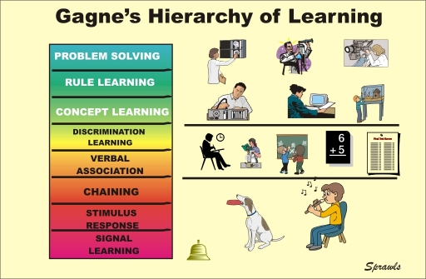
II.

Slide 11
Signal Learning- Learn how to respond to a signal, like Pavlov’s dog (Pavlov’s classical conditioned response) Usually the response is emotional
Stimulus(S) – Response(R) Learning- Learn precise response to precise signal / stimulus Different from signal learning, signal learning leads to involuntary responses, whereas the responses in S-R learning are voluntarily controlled.
Psychomotor Connection Learning- Occurs when a chain of stimuli and responses are formed to follow procedures. Able to chain 2 or more stimulus-response

Slide 12
Verbal Association Learning- Use terminology in verbal chains
Multiple Discrimination Learning- Learn how to distinguish between similar stimuli Make different responses to each type of stimulus, even when they may be perceptually similar
Concept Learning- Singular / common response to an entire class of stimuli
Principle Learning- Viewed as a chain of two or more concepts. Learn to apply rules
Problem Solving- Highest learning type which lead to the discovery of higher order rules. All other types of learning must have been completed for it to be present.

Slide 13
III.Learning Outcomes
Intellectual Skills - Having procedural knowledge, 'Knowing How'
Verbal Information - Having declarative knowledge, 'Knowing That'
Cognitive Strategy - Techniques for problem solving
Motor Skills - Executing movements in an organized manner
Attitude - Mental state that influences the choices of personal actions

Slide 14
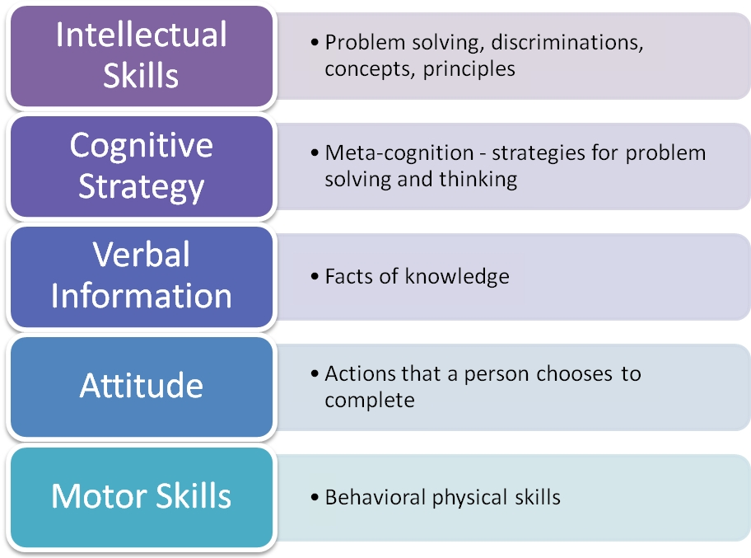

Slide 15
Educational implications
Skills should be learned one at a time
Each new skill learned should build on previously acquired skills.
The analysis phase must identify and describe the prerequisite lower level skills and knowledge required for an instructional objective,
Lower level objectives must be mastered before higher level ones,
Objectives must be stipulated in concrete behavioral terms,
Positive reinforcement should be used in a repetitive manner

Slide 16


